Slide 1









Climatological Analysis of Tempe Town Lake
Sicily Vicera
Mentors: Dr. Hilairy Hartnett, Dr. Sean Bryan

Slide 2
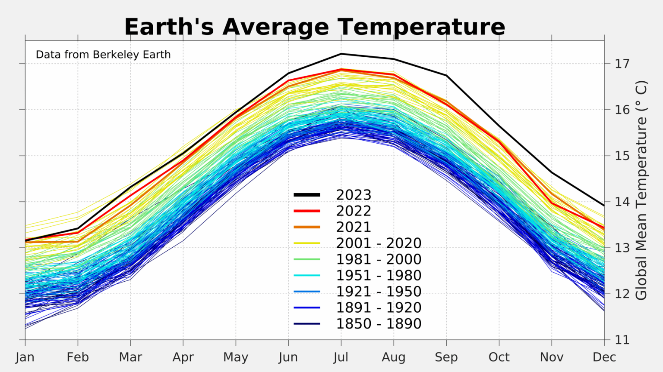
A Warming World

Slide 3
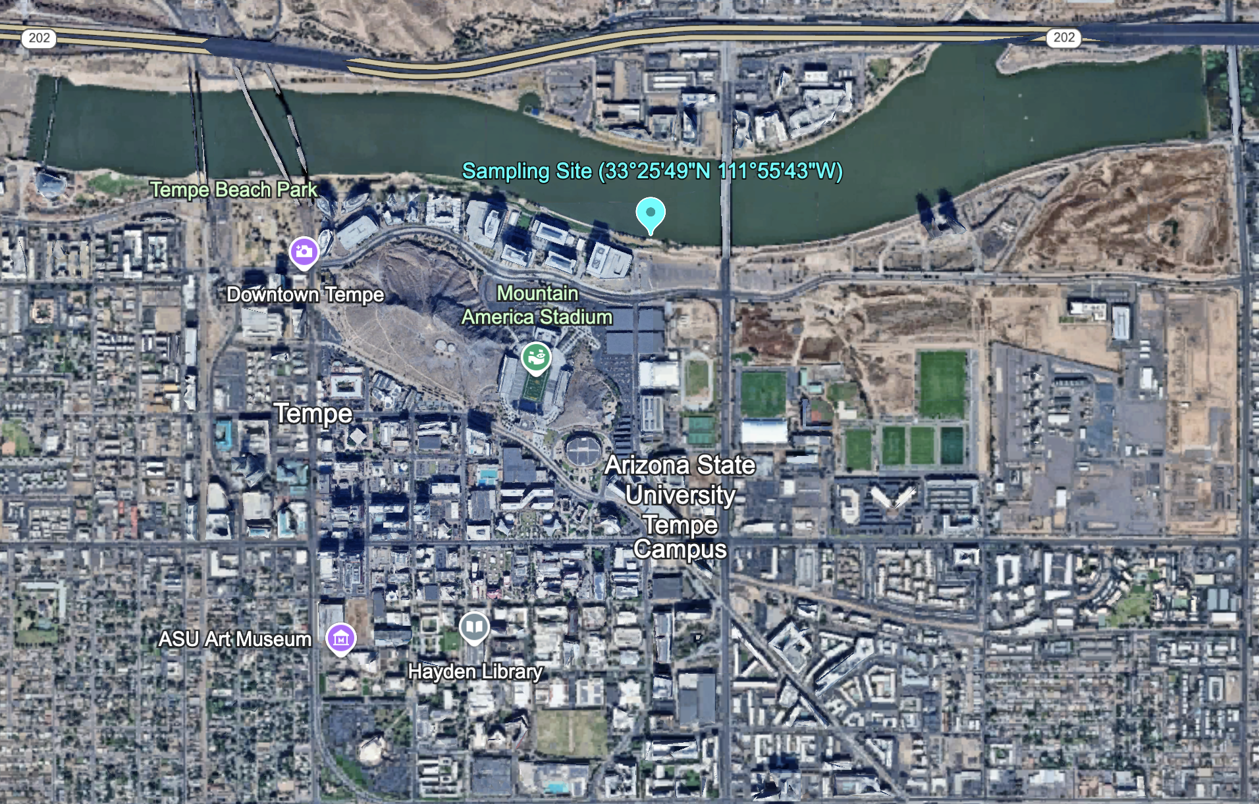
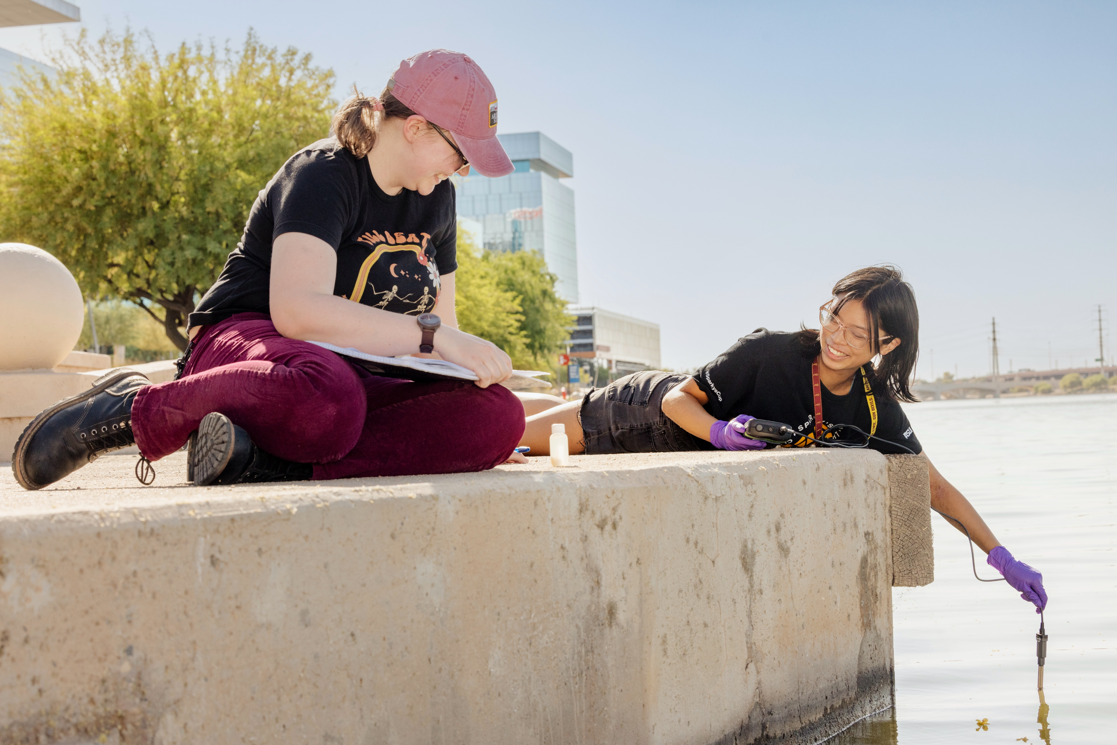
Tempe Town Lake
Artificial, urban lake in Tempe, AZ
Evidence of an ecosystem with temporal variation
Long-term lake monitoring (20+ years)
Sampling site for the CaNdy Lab

Slide 4
Q: Is Tempe Town Lake warming?

Slide 5

Available Datasets
Biweekly sampling
2005-2024
Field measurements + lab analysis
Weekly sampling
2000-2023
City of Tempe
Publicly available
Sampling every 30 minutes
2018-present
In situ dataSONDE

Slide 6
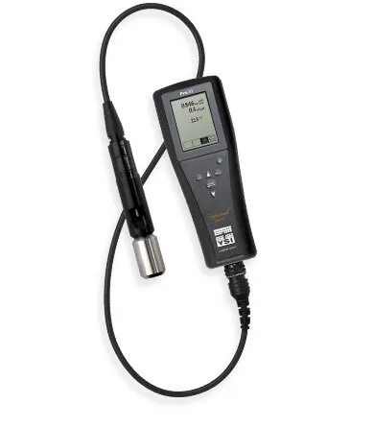




Methods and Workflow
CaNdy Lab sampling
Data cleaning and formatting
Learning to code in Python
Debugging

Slide 9
Conclusions
TTL warms gradually, then cools rapidly near the end of each year.
There are clear patterns daily, seasonally, and annually.
2009 and 2018 had the highest peak summer temperatures.
Honors Thesis will explore other parameters.
High-resolution 30-minute data is available.
Lake monitoring should continue.
Questions?

